Slide 1
LOA- Leave of Absence
Objective- Predict which employees are likely to take leave of absence in the next 90 days.
Business Use Case- Knowing who is likely to take leave of absence will enable employers to proactively reach out with guidance on navigating the LOA process and explain how benefits coverage works while out on leave.

Slide 2
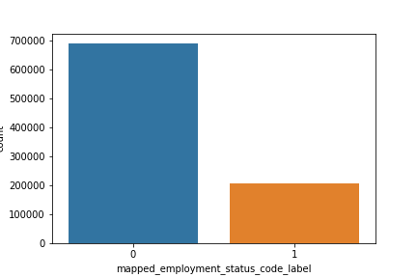
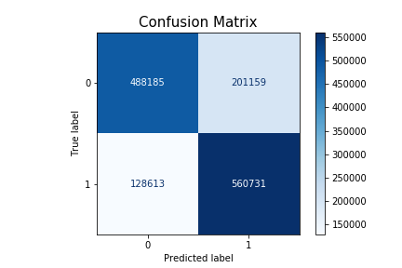
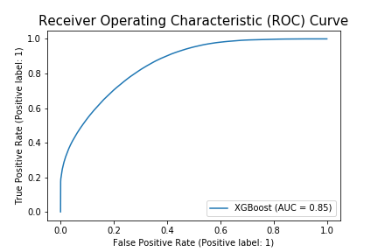
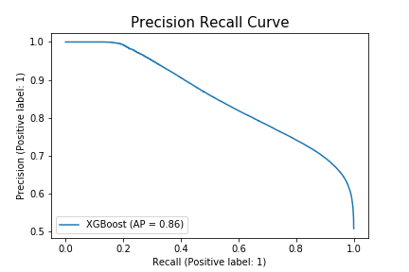
Leave of Absence (Results on Training Set - 80% of Data)
Train Set Shape Before Smote– Rows:895390, Columns:10
Final Train Set Shape– Rows:1378688, Columns:44 (After Smote and One Hot Encoding )
Best Algorithm –> XGBoost
Recall -> 81.3
Precision -> 73.5
Accuracy -> 76
ROC AUC -> 85.4
AUPRC -> 85.5
F1 -> 77.2

Slide 3

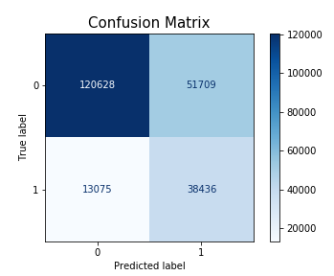
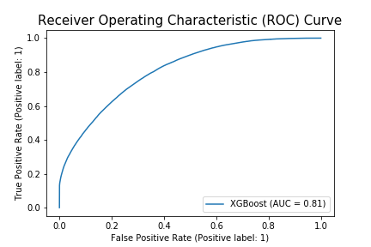
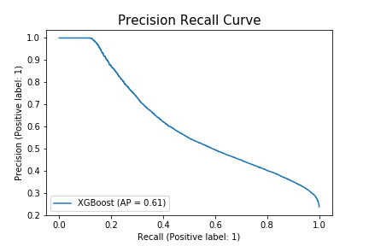
Leave of Absence (Results on Testing Set - 20% of Data)
Shape of Test Data- Rows:223848, Columns:44
Best Algorithm –> XGBoost
Recall -> 74.6
Precision -> 42.6
Accuracy -> 76
ROC AUC -> 81
AUPRC -> 61.1
F1 -> 54.3

Slide 4
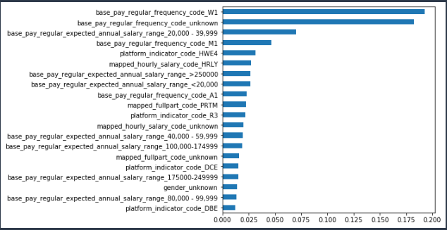
Top 20 Features based on Feature Importance Score

Slide 5
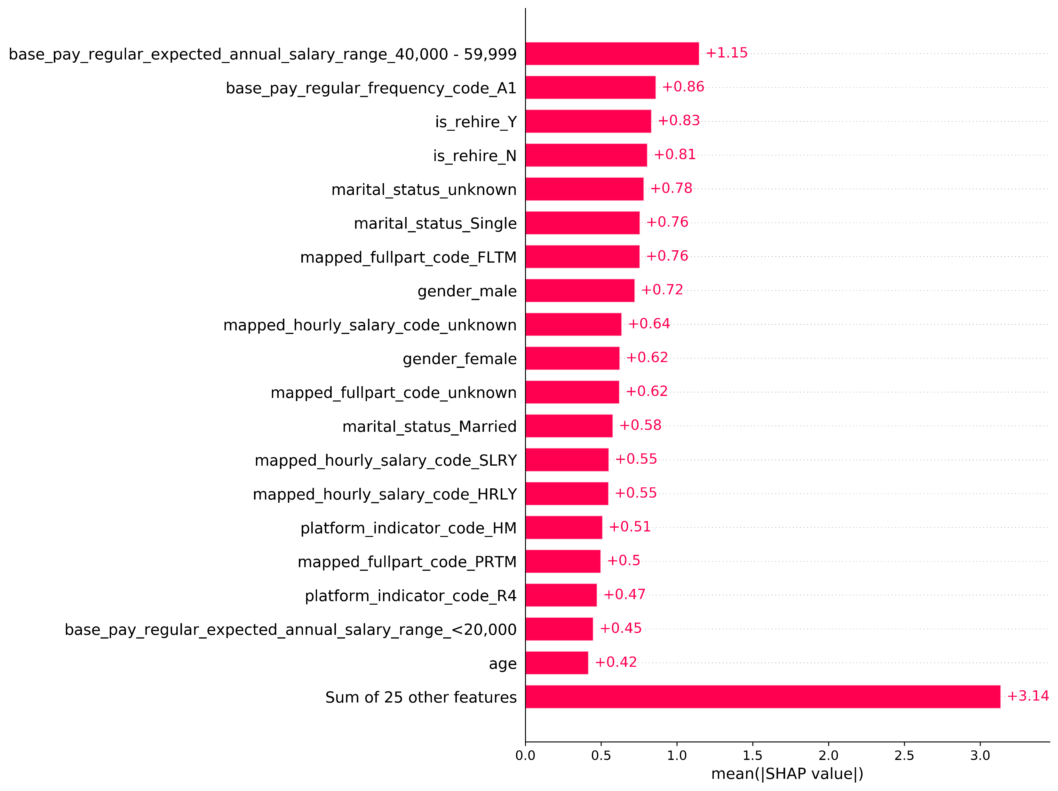
Top 20 Features based on Mean SHAP Values

Slide 6
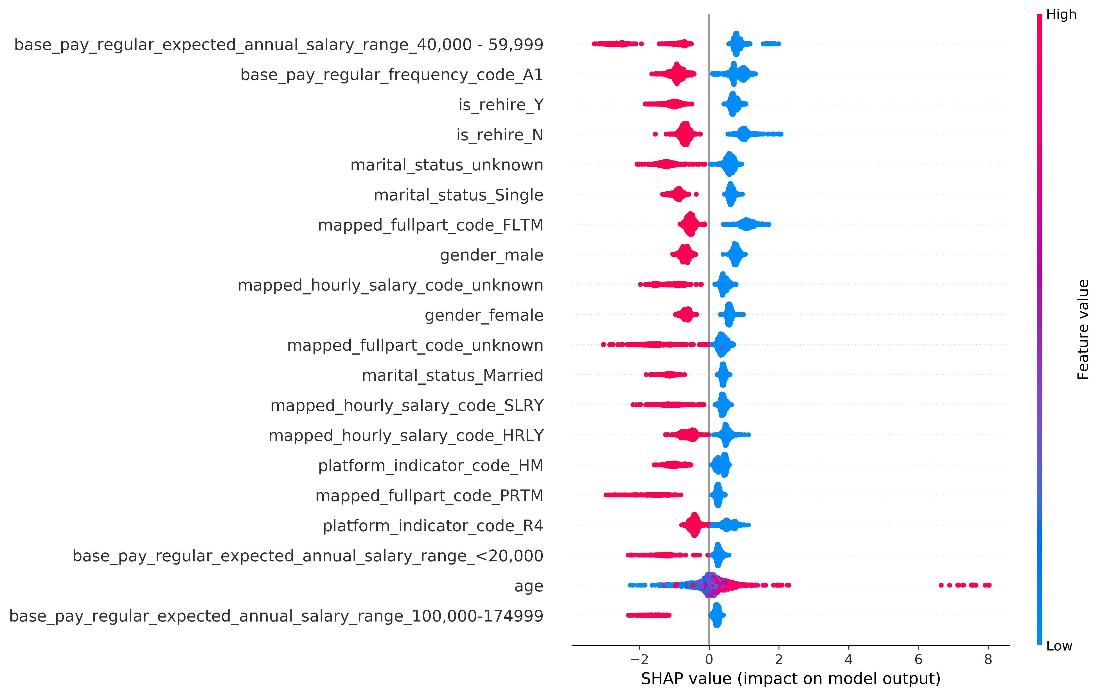
SHAP Values Summary Plot

Slide 7
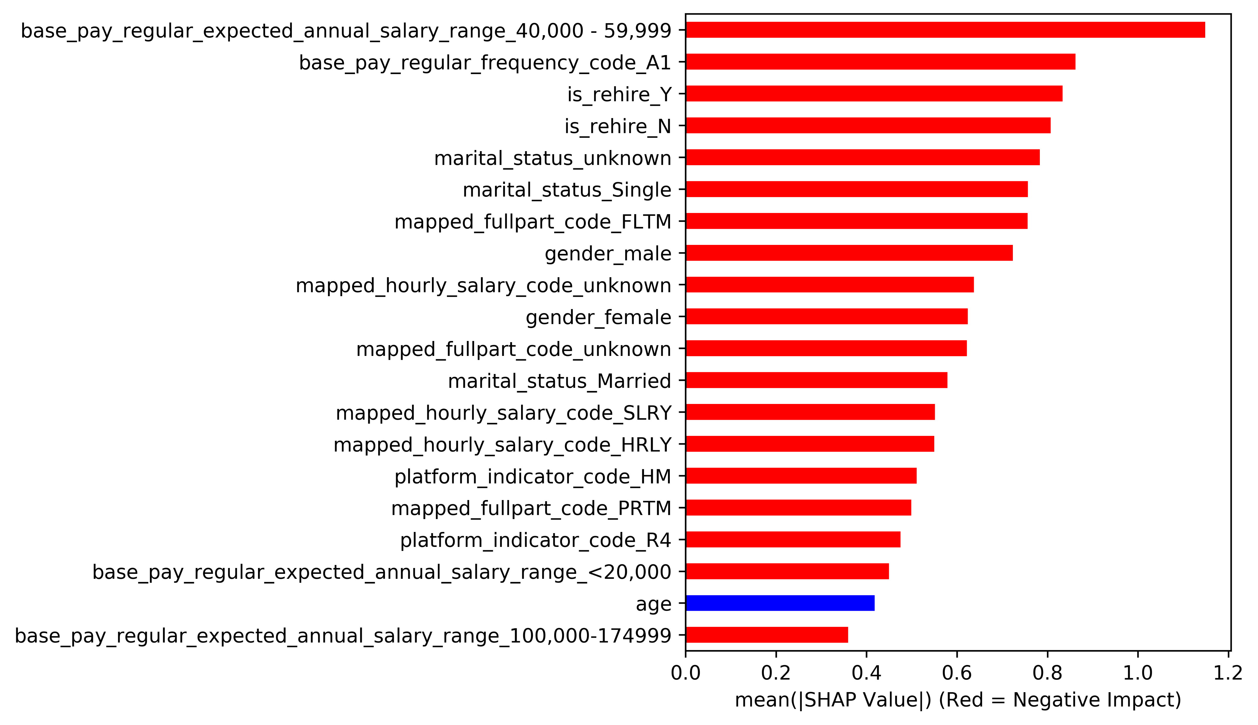
Top 20 Features based on Mean SHAP Values

